Slide 1
Review
A brief look at some of the topics discussed in Comp1510 and possibly a few new things

Slide 2
Class
Are a data structure that employs two important concepts found in OOP: Encapsulation; and Information Hiding

Slide 3
Encapsulation
Refers to putting both data and the methods (functions) that work on the data together
Benefit of encapsulation is reliable data changes (often known as state). Methods know all about the data they work on.

Slide 4
Information Hiding
Works in conjunction with Encapsulation
Data is kept “private” (hidden) to the methods that are encapsulated with the data
Prevents outside functions from direct access to data thus protecting the data from changing incorrectly

Slide 5
Objects vs Classes
Classes are a data type like “int” or “double” (but more sophisticated)
You do not work with “int” or “double” the data type but with an “object” of these types

Slide 6
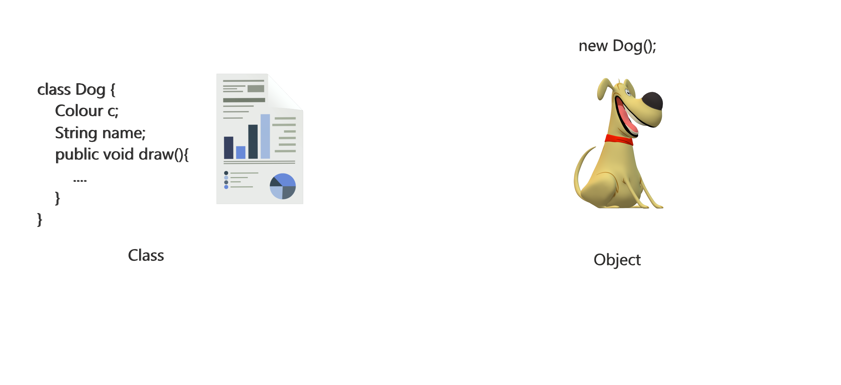
class Dog{} vs new Dog()

Slide 7
References
A pointer (you’ll learn about those in C) to the object
Think of a remote control unit. The remote control is NOT the TV but a way to manipulate the TV. The same remote may control many TVs, but it must be “pointed” (assigned) to a particular TV in order for you to work with that TV
Since parameters are passed to methods via pass-by-value only a copy of the reference to an object is made (good reason to always use “final” for parameter declarations)
Notes:
Re-examine swap?
Sept 2011

Slide 8
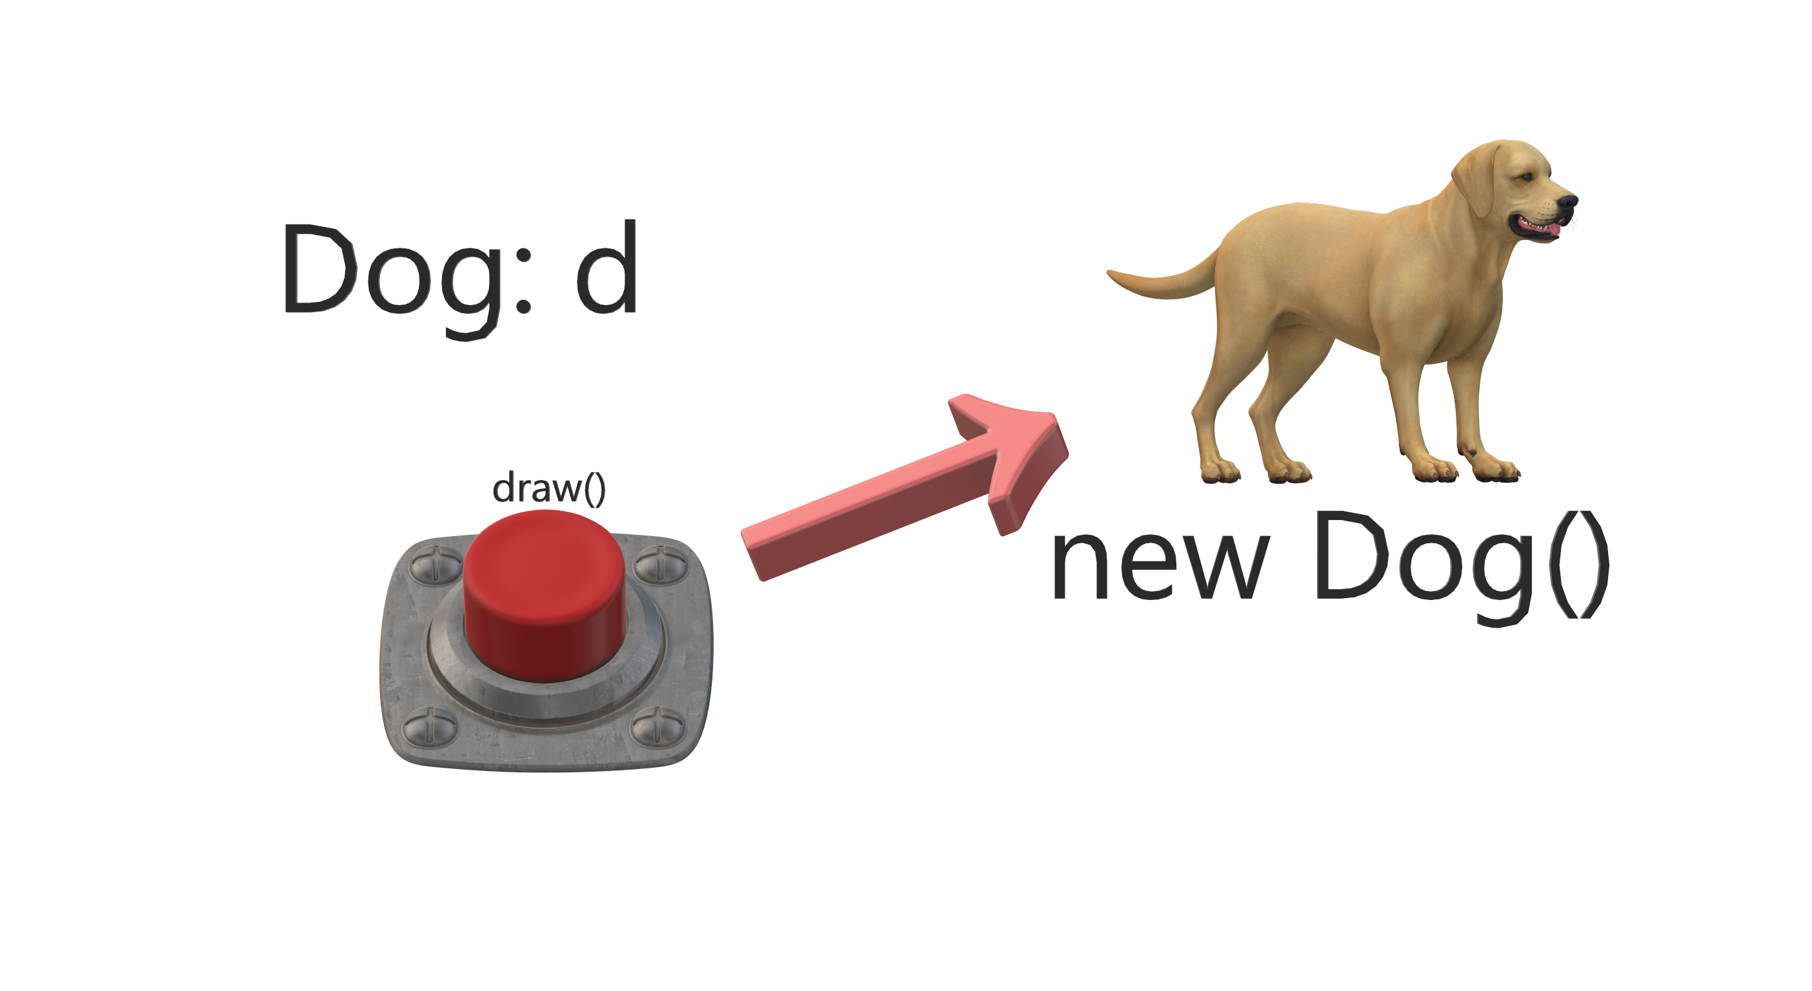
Dog d = new Dog()

